Slide 1
The Standard Template Library
Acknowledgements to Phil Ottewell's STL Tutorial

Slide 2
// STL1.cpp : Here is a standard C++ program to read a list of integers,
// sort them and print them:
#include "stdafx.h"
#include <iostream>
using namespace std;
int cmp (const void *a, const void *b);
main (int argc, char *argv[])
{
const int size = 1000; // array of 1000 integers
int array [size];
int n = 0;
cout << "Please enter a series of integers, terminated by ctl-Z: ";
// read an integer into the n+1 th element of array
while (cin >> array[n++]);
n--; // it got incremented once too many times
qsort (array, n, sizeof(int), &cmp); // & is not required
for (int i = 0; i < n; i++)
cout << array[i] << endl;
}
// a and b point to integers. cmp returns -1 if a is less than b,
// 0 if they are equal, and 1 if a is greater than b.
inline int cmp (const void *a, const void *b)
{
int aa = *(int *)a;
int bb = *(int *)b;
return (aa < bb) ? -1 : (aa > bb) ? 1 : 0;
}

Slide 3
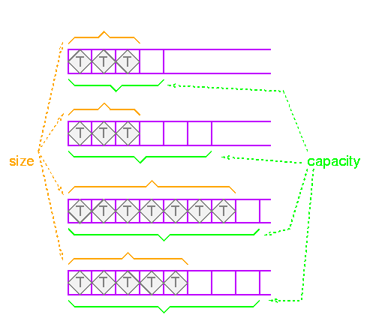
Containers - Vectors
Contiguous allocated storage (dynamic array).
Inserts in the middle move things “up”. (invalidates references, iterators, and pointers).
Inserts at the end increase the size of the vector.

Slide 4
Vectors
#include <vector>
The vector class is similar to an array, and allows array-type syntax, e.g. my_vector[2] . A vector is able to access elements at any position (referred to as "random" access in the preceding table) with a constant time overhead, O(1). Insertion or deletion at the end of a vector is "cheap". As with the string, no bounds checking is performed when you use operator [].
Insertions and deletions anywhere other than at the end of the vector incur overhead O(N), N being the number of elements in the vector, because all the following entries have to be shuffled along to make room for the new entries, the storage being contiguous. Memory overhead of a vector is very low and comparable to a normal array.

Slide 5
Vector methods
vector<Class> v; //empty vector constructor
vector<Class> v(v2); //copy constructor – copies all elements.
vector<Class> v(int); //creates a vector with n elements using the default element constructor.
v.size() number of actual elements
v.capacity() number of elements before reallocation.
v.at(idx) and v[idx] both return a reference to the element at position idx (counting from zero).
v.front() and v.back() returns first and last element.

Slide 6
Vector methods continued
v.insert(pos, element) inserts element at pos, and moves everything up.
v.push_back(element) appends element to the end.
v.pop_back removes the last elements (does not return it).
v.erase(pos) removes the element at iterator position pos (moves everything down).
v.clear() removes all elements
v.begin() returns a random access iterator for the last element.
v.end() returns a random access iterator for the position after the last element.

Slide 7
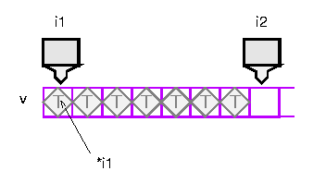
Iterators
//Iterators provide a way of specifying a position
//in a container. An iterator can be incremented or
//dereferenced, and two iterators can be compared.
vector<int> v;
// add some integers to v
vector::iterator i1 = v.begin();
vector::iterator i2 = v.end();

Slide 8
Sort using an Iterator
#include "stdafx.h"
#include <algorithm>
#include <vector>
#include <iostream>
using namespace std;
main ()
{
vector<int> v; // create an empty vector of integers
int input;
cout << "Please enter a set of integers, terminated with ctl-Z: ";
while (cin >> input) // while not end of file
v.push_back (input); // append to vector
sort(v.begin(), v.end());
size_t n = v.size();
for (unsigned int i = 0; i < n; i++)
cout << v[i] << endl;
}

Slide 9
Iterators continued
// STL3.cpp : More on Algorithms and Iterators
#include "stdafx.h"
#include <iostream>
#include <vector>
#include <algorithm> // Needed for random_shuffle
using namespace std;
main (int argc, char *argv[])
{
if (argc != 2) {
cout << "Usage: STL3 <int>" << endl;
return EXIT_FAILURE;
}
int n = atoi (argv[1]); // argument checking removed for clarity
vector<int> v;
for (int i = 0; i < n; i++) // Append integers 0 to n-1 to v
v.push_back (i);
// shuffle
random_shuffle (v.begin(), v.end());
// Note the use of ++ and !=
for (vector<int>::const_iterator p = v.begin(); p != v.end(); p++)
cout << *p << endl; // Note the dereference.
}

Slide 10
Iterator Operations
* (dereference)
++ (and often --)
== and !=
= (assignment)
c.begin() returns an iterator referencing the first element.
c.end() returns an iterator referencing one past the last element.

Slide 11
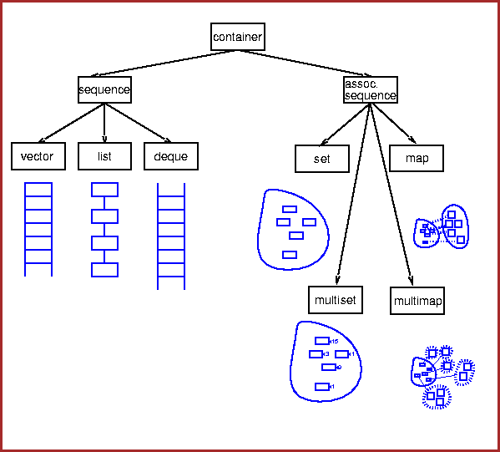
STL Container Hierarchy

Slide 12
Sequences
Sequences
  Sequential set of objects; you can insert elements at any point in the sequence, but the performance will depend on the type of sequence and where you are inserting.
Vectors
  Fast insertion at end, and allow random access.
Lists
  Fast insertion anywhere, but provide only sequential access.
Deques
  Fast insertion at either end, and allow random access. Restricted types, such as stack and queue, are built from these using adaptors.
Stacks and queues
  Provide restricted versions of these types, in which some operations are not allowed.

Slide 13
Associative Containers
Associative containers
  Associative containers are a generalization of sequences. Sequences are indexed by integers; associative containers can be indexed by any type.
  The most common type to use as a key is a string; you can have a set of strings, or a map from strings to employees, and so forth.
Sets
  Sets allow you to add and delete elements, query for membership, and iterate through the set. No duplicates allowed.
Multisets
  Multisets are just like sets, except that you can have several copies of the same element (these are often called bags).
Maps
  Maps represent a mapping from one type (the key type) to another type (the value type). You can associate a value with a key, or find the value associated with a key, very efficiently; you can also iterate through all the keys.
Multimaps
  Multimaps are just like maps except that a single key can be associated with several values.

Slide 14
Deque
#include <deque>
The double-ended queue, deque (pronounced "deck") has similar properties to a vector, but as the name suggests you can efficiently insert or delete elements at either end.
begin() Returns iterator pointing to first element
end() Returns iterator pointing after last element
push_front(...) Add element to front of deque
pop_front(...) Destroy element at front of deque
push_back(...) Add element to end of deque
pop_back(...) Destroy element at end of deque
swap( , ) Swap two elements
insert( , ) Insert new element
size() Number of elements in deque
capacity() Element capacity before more memory needed
empty() True if deque is empty
[ ] Random access operator A deque, like a vector, is not very good at inserting or deleting elements at random positions, but it does allow random access to elements using the array-like [] syntax, though not as efficiently as a vector or array. Like the vector an erase() or insert() in the middle can invalidate all existing iterators.

Slide 15

Deque Example - Blackjack

Slide 16
Lists
#include <list>
Lists don't provide [ ] random access like an array or vector, but are suited to applications where you want to add or remove elements to or from the middle. They are implemented as double linked list structures in order to support bidirectional iterators, and are the most memory-hungry standard container, vector being the least so. In compensation, lists allow low-cost growth at either end or in the middle.

Slide 17
Lists
begin() Returns iterator pointing to first element
end() Returns iterator pointing after last element
push_front(...) Add element to front of list
pop_front(...) Destroy element at front of list
push_back(...)Add element to end of list
pop_back(...) Destroy element at end of list
swap( , ) Swap two elements
erase(...) Delete elements
insert( , ) Insert new element
size() Number of elements in list
capacity() Element capacity before more memory needed
empty() True if list is empty
sort() Specific function because <algorithm> sort routines expect random access iterators

Slide 18

List Example
“Phone Book”

Slide 19
Container Caveats
Be aware that copy constructors and copy assignment are used when elements are added to and (in the case of the vector and deque) deleted from containers, respectively.
When you put an object in a container, the copy constructor will be called. If you erase elements, then destructors and copy assignments (if other elements need to be shuffled down) will be called.

Slide 20
To refresh your memories, copy constructor and copy assignment member functions look like this example:
class MyClass {
public:
// Copy constructor
MyClass( const MyClass &mc ) {
// Initialize new object by copying mc.
// If you have *this = mc , you'll call
// the copy assignment function
}
// Copy assignment
MyClass & operator =( const MyClass &mcRHS ) {
// Avoid self-assignment
if ( this != &mcRHS ) {
// Be careful not to do *this = mcRHS
//or you'll loop.
}
return( *this );
}
};

Slide 21
Allocators
Allocators do exactly what it says on the can. They allocate raw memory, and return it. They do not create or destroy objects. Allocators are very "low level" features in the STL, and are designed to encapsulate memory allocation and deallocation. This allows for efficient storage by use of different schemes for particular container classes. The default allocator, alloc, is thread-safe and has good performance characteristics. On the whole, it is best to regard allocators as a "black box", partly because their implementation is still in a state of change, and also because the defaults work well for most applications. Leave well alone !

Slide 22
Sequence Adapters
Sequence container adapters are used to change the “interface" to other STL sequence containers.
Why might you want to do this?
  If you wanted to implement a stack of items, you might at first decide to base your stack class on the list container - let's call it ListStack - and define public member functions for push(), pop(), empty() and top().
  However, you might later decide that another container like a vector might be better suited to the task. You would then have to define a new stack class, with the same public interface, but based on the vector, e.g. VectorStack, so that other programmers could choose a list or a vector based queue.
  It is obvious that the number of names for what is essentially the same thing start to mushroom.
Container adapters neatly solve this by presenting the same public interface irrespective of the underlying container. Being templatized, they avoid name proliferation. Provided the container type used supports the operations required by the adapter class, you can use any type for the underlying implementation. It is important to note that the adapters provide a restricted interface to the underlying container, and you cannot use iterators with adapters.

Slide 23
Stack
#include <stack>
The stack implements a Last In First Out, or LIFO structure, which provide the public functions push(), pop(), empty() and top(). Again, these are self explanatory - empty returns a bool value which is true if the stack is empty. To support this functionality stack expects the underlying container to support push_back(), pop_back(), empty() or size() and back()

Slide 24
Stack
Container Function | Stack Adapter Function
back() | top()
push_back() | push()
pop_back() | pop()
empty() | empty()
size() | size()
You can use vector, deque or list as the underlying container type.
If you wanted a user written type as the container, then if it provided the necessary public interfaces, you could just "plug" it into a container adapter.

Slide 25

Stack Demo

Slide 26
Queue
#include <queue>
A queue implements a First In First Out, or FIFO structure.
It provides the public functions
  push()
  pop()
  empty()
  back()
  front()
To support these, queue expects the underlying container to have push_back(), pop_front(), empty() or size() and back()

Slide 27
Queue
Container Function | Queue Adapter Function
front() | front()
back() | back()
push_back() | push()
pop_front() | pop()
empty() | empty()
size() | size()
You can use deque or list as the underlying container type, or a user-written type. You can't use a vector because vector doesn't support pop_front(). You could write a pop_front() function for vector, but this would be inefficient because removing the first element would require a potentially large memory shuffle for all the other elements, taking time O(N).

Slide 28

Queue Demo

Slide 29
Priority Queue
#include <queue>
A priority_queue, is similar to a queue, with the additional capability of ordering the objects according to a user-defined priority. The order of objects with equal priority is not predictable, except, of course, they will be grouped together. This might be required by an operating system process scheduler, or batch queue manager.
The underlying container has to support push_back(), pop_back(), empty(), front(), plus a random access iterator and comparison function to decide priority order.

Slide 30
Priority Queue
Container Function | Priority Queue Adapter Function
front() | top()
push_back() | push()
pop_back() | pop()
empty() | empty()
size() | size()
[ ] random iterators | Req’d to support heap ordering
A vector or a deque can be used as the underlying container, or a suitable user-provided class.

Slide 31

Priority Queue Demo

